Slide 1
22576VIC Certificate III in Acting (Screen)
Nationally accredited training
2020

Slide 2
Welcome to VET Acting
Vocation, Education and Training
Acting for screen
Acting in front of camera
Building knowledge about our industry
Transferring knowledge into skills

Slide 3
Know your course code and name - 22576VIC Certificate III in Acting (Screen)
VET means vocation, education and training
This certificate course is nationally accredited
16 Units of Competencies to be completed over two years, continual assessment marked as Satisfactory or Not yet satisfactory leading
to COMPETENCE.
Year 1’s receive a statement of attainment in UOC’s that are passed
(8 UOC’s in total)
Year 2 are awarded the certificate
(7 core UOC’s and 1 elective)

Slide 4
Expectations
Good attitude to learning
Being trained for employability skills
Working to deadlines
Many of you act for theatre but this is a film and television course and there are different techniques involved. Be prepared to transfer those skills to screen.
As with any acting, you must know your lines.

Slide 5
Please do
Put your name, cluster, mobile number and a gmail in the chat bar.
Have you got information about the course from your cluster handbook or school? If, not let me know on the chat bar.
Please join Google Classroom (better to use a gmail than school email). See you cluster GC code.

Slide 6
About us
Course Snapshot Video - https://www.youtube.com/watch?v=7pD8BmX4XeU
Student Interviews Video - https://www.youtube.com/watch?v=5IZgZ88eOaA

Slide 7
Year 1 - 8 Core Units of Competency Study hours around 250
CODE | Nominal Hours | TITLE
BSBXTW301 | 40 | Work in a team
BSBPEF301 | 30 | Organise personal work priorities
CUAWHS302 | 10 | Apply work health and safety practices
CUAIND201 | 20 | Develop and apply creative arts industry knowledge
CUAMPF302 | 35 | Prepare for performances
VU23078 | 45 | Prepare and present self for auditions
VU23079 | 45 | Develop script knowledge and performance skills
VU23080 | 45 | Develop acting techniques

Slide 8
How the UOC’s interconnect
Work in a team
WORK & COMMUNICATE IN A GROUP
Develop and apply creative arts industry knowledge.
KNOW OUR INDUSTRY
Organise personal work
BE RESPONSIBLE FOR YOUR OWN WORK
Apply work health & safety
WORK SAFELY
Prepare and present self for auditions
ACTING
Develop script knowledge and performance skills
ACTING
Develop acting techniques
ACTING
Prepare for performances
ACTING

Slide 9
Face to face learning
We are a face to face delivery course but we will blend some of our work online for industry currency.
Our industry is global, we can audition anywhere in the world!
We use the online platforms of Zoom or Google meet.

Slide 10
Attendance – Duty of care
Good (exemplary) attendance is essential to ensure you reach competency in all UOC’s.
Attendance is taken every lesson. Do not be late, continual lateness will put you AT RISK of not completing enough hours. See your cluster handbook.
A student may not leave the class for any reason unless it has been approved beforehand by parent/VET coordinators and ACDA.
Absences are allowed for ESSENTIAL school related reasons or illness. Parents must phone or email ACDA. School absences to be emailed by home school VET coordinator.
Let us know ahead of time please, preferably NOT on the day
Classmates are not permitted to advise us that you are absent.
Email absences to: admin@acda.vic.edu.au

Slide 11
Class materials
Supplied:
Hard copy - Learners Manual (LM)
Online resources - on Google Classroom (GC)
The Learners Manual contains your lesson plans, they are divided into ACTS
SD card for filming
Need to bring to every class:
Laptop and Sd card reader/hub
LM and SD card
Notebook and pen
No phones are to be used in class
Note: If you are not digitally confident then let us know on the chat bar please - select Danaë for PM.

Slide 12
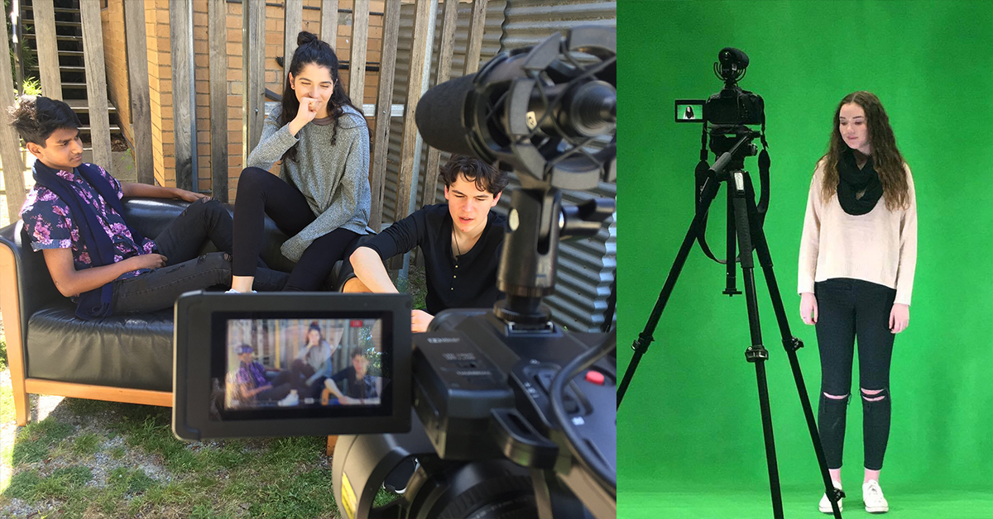

Slide 13
What to wear to class:
Home School requirements: wear your uniform when travelling directly from your school.
For FILMING requirements please bring a change of CLOTHES (costume) as necessary.

Slide 14
VET INDUSTRY DAYS
Compulsory Excursion
and
Action Acting incursion
where you work with current Industry professionals

Slide 15
Agent/Manager

Slide 16
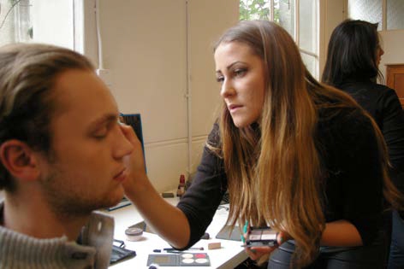
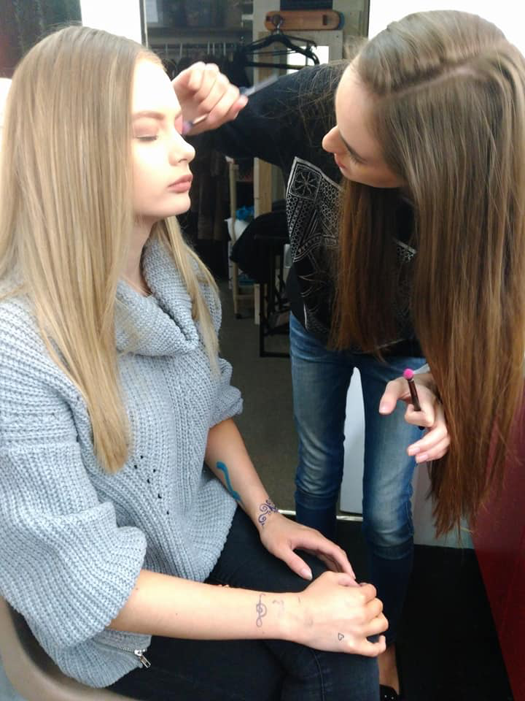
Make up

Slide 17
Class Locations
Brimbank Classes – Taylors Lakes Secondary College, Taylors Lakes
IMVC Year 1 Class – St Mary’s College, Windsor
IMVC Year 2 Class – St Mary’s College, Windsor
Lower Hume Classes – Assumption College, Kilmore
Mullum Classes - MBCTA Theatre, Boronia
Peninsula Classes – Elizabeth Murdoch College, Langwarrin
Yarra Valley Classes – Lilydale High School, Lilydale
Starting Date: Week of February 12 2024

Slide 18
Website: acda.vic.edu.au
Student Induction Information (SII) and Year 1 Orientation PowerPoint will be on our website soon.
They give essential information for you and your parents.
You will soon receive an email from us for electronic enrolment, please enrol as soon as possible, if you have problems then email admin@acda.vic.edu.au

Slide 19
Enjoy your VET studies
Your VET qualification is recognised Australia wide and will sometimes contribute as RPL/credit transfer when undertaking more advanced qualifications.
Ensure you give VET your full attention to achieve the best possible outcome for yourself… it will be worth it!

Slide 20
The Australian College of Dramatic Arts
CEO/Principal Teacher
Merilyn Brend
CEO/Technical Advisor & Assessor
Bill Robinson
Administrative staff
Nikki Wellington
Karen Haymes
Danaë Grieef
Film Director and Editor
Alex Lowes

